Slide 1
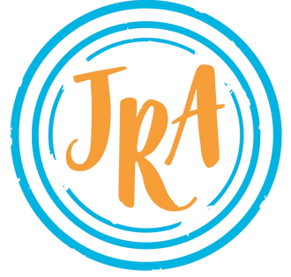

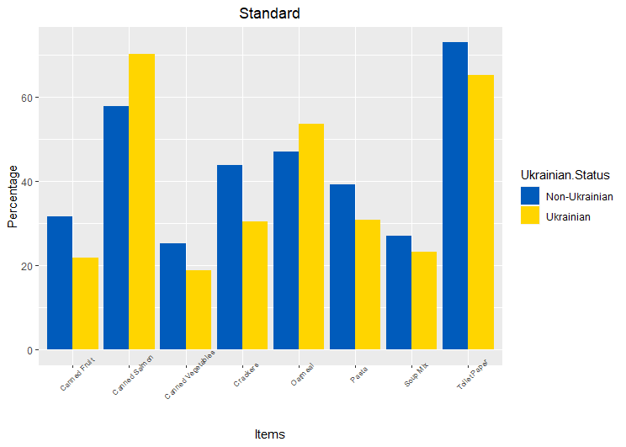
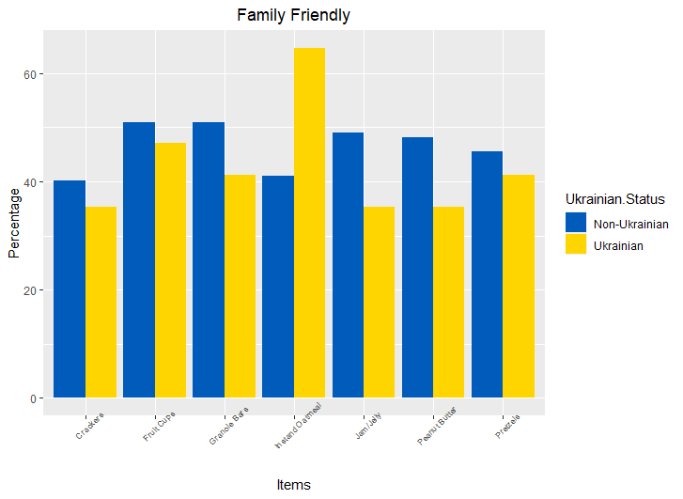
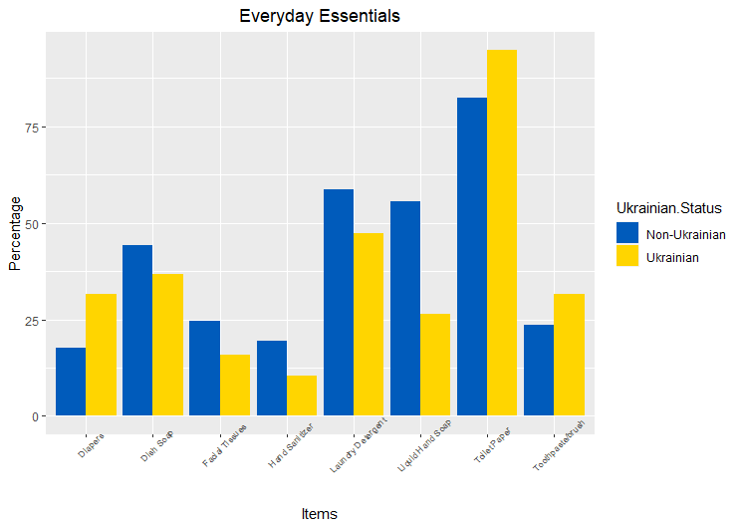
Food Box Preferences: Ukrainians vs. Non-Ukrainians
Evan Parker
In collaboration with Professor Laura Pyott, the Jewish Relief Agency of Philadelphia
Department of Mathematics, West Chester University of Pennsylvania
Abstract
The Jewish Relief Agency of Philadelphia (JRA) is a non-profit organization that provides a monthly food box to those in need. In January of 2022, about 2,000 surveys were mailed to a sample of JRA clients. The survey collects demographic data, level of satisfaction, food preferences, and connection to the Jewish community. To date, over 800 surveys have been returned and entered into a database. In the survey, clients are asked to name the top 5 items they enjoy receiving in the food boxes. Given the recent Russian invasion of Ukraine, I chose to analyze Ukrainians versus non-Ukrainians in this topic area to determine if there is a cultural difference in item preferences. To show this possible cultural difference, I plan on utilizing bar graphs and analytical breakdowns of items per country. I hypothesize that there is a cultural difference in some items, as some countries use specific items in their dishes more than others.
Analysis
Standard
The Standard JRA Food Box consists of numerous food items to feed the general public.
Within the Standard Box, recipients can receive Toilet Paper, Masks, Soap, Canned Tuna,
Canned Salmon, Oatmeal, Pasta, Canned Beans, Canned Fruit, Canned Vegetables, Soup
Mix, Cooking Oil, and Crackers. Of those who completed the feedback survey, 285
Ukrainians chose their favorite items, and 816 non-Ukrainians chose theirs. Shown in the
graph to the right are the percentages of each item picked for both Ukrainians and
Non-Ukrainians. Omitted from the graph for both lack of difference and for ease of reading
are Masks, Soap, Canned Tuna, Canned Beans, and Oil. Ukrainians preferred Canned Salmon
and Oatmeal, while Non-Ukrainians preferred all other shown items.
Family Friendly
The Family Friendly Food Box consists of food items that are made primarily for those with
children to help fill their school lunchboxes. Within the Family Friendly Food Box, recipients
can receive Peanut Butter, Jam/Jelly, Crackers, Pretzels, Fruit Cups, Granola Bars, and Instant
Oatmeal. Of those who completed the feedback survey, 17 Ukrainians chose their favorite
items, and 112 Non-Ukrainians chose theirs. Shown in the graph to the right are the
percentages of each item picked for both Ukrainians and Non-Ukrainians. All items in the
Family Friendly Food Box are shown on the graph. Overall, Ukrainians were not as fond of
the items within the Family Friendly Food Box compared to Non-Ukrainians apart from
Instant Oatmeal.
Everyday Essentials
The Everyday Essentials Bag consists of toiletries and household cleaning items that were
particularly scarce during the height of the COVID-19 pandemic. Within the Everyday
Essentials Bag, recipients can receive Toilet Paper, Paper Towels, Bar Soap, Laundry
Detergent, Dish Soap, Facial Tissues, Toothpaste/Toothbrush, Liquid Hand Soap, Hand
Sanitizer, Incontinence Supplies, and Diapers. Of those who completed the feedback survey,
19 Ukrainians chose their favorite items, and 97 Non-Ukrainians chose theirs. Shown in the
graph to the right are the percentages of each item picked for both Ukrainians and
Non-Ukrainians. Omitted from the graph for both lack of difference and for ease of reading
are Paper Towels, Bar Soap, and Incontinence Supplies. Ukrainians preferred Diapers, Toilet
Paper, and Toothpaste/Toothbrushes when compared to Non-Ukrainians.
About the JRA
“Jewish Relief Agency (JRA) was founded in 2000 as a volunteer-led hunger-relief organization working to inspire volunteerism in Philadelphia, under the conviction that no member of our community should be hungry.”
“Through a monthly Food Distribution Program, the JRA harnesses the power of hundreds of volunteers to deliver kosher, nutritious food assistance and essential home supplies to thousands of low-income households each month. ”
“Today, the JRA serves over 6,800 diverse, low-income individuals across Greater Philadelphia. The JRA continues to create positive change by bringing people of all ages, backgrounds, and abilities together” (JRA)
Conclusions
In conclusion, most of the items except for Instant Oatmeal and Liquid Hand Soap, were similar in preference for both Ukrainians and Non-Ukrainians.
Methods
First, our team manually entered all paper copies of the surveys into a database, which was later imputed into R. Then, I used R to split the data set by Ukrainian origin, the obtain the counts for each food box item. Next, I manually calculated the percentages for the items to be used for the bar charts. Finally, I used R to generate the bar graphs for each food box type, omitting items without strong differences for ease of readability.
References
Jewish Relief Agency. “About Us.” Jewish Relief Agency, 2021, https://jewishrelief.org/about-us-1.
Make Peace,
Not War
#WeStand
WithUkraine

